Slide 1

M4 Project Work: First Tables and Graphs Presentation
NEXTGEN
ANALYTICS
TEAM MEMBERS:
Sylvester Vhashe
Bekithemba Nkomo
Innocent Mujokoro
Tapiwanashe Mutarimanja

Slide 2
TITLE :
Data-Driven Enforcement for Improved Housing Conditions and Code Compliance in NYC
Welcome to our analysis of housing conditions and code compliance in New York City, where we leverage data to understand tenant experiences and identify critical areas for improvement.

Slide 3
IMPROVEMENTS For a better presentation we have re arranged the flow of slides. New tables have been added. A new chart with new insights has also been added.

Slide 4



Table 1 : Complaints leading to violations
Key Insights from the "Boroughs with the Most Complaints Leading to Violations" Table:
Brooklyn has the Highest Complaint Volume: Brooklyn has significantly more complaints (449,391) than any other borough, more than double the next highest (Bronx).
Bronx has the Highest Percentage of Complaints Leading to Violations: While Brooklyn has the most complaints, the Bronx has the highest percentage of those complaints resulting in violations (46%). This suggests a potential issue with the severity or validity of complaints in the Bronx.
Queens has the Lowest Percentage of Complaints Leading to Violations: Queens has the lowest percentage of complaints resulting in violations (21%). This could indicate a more efficient resolution process or potentially a lower rate of valid complaints.
Staten Island has the Lowest Complaint Volume: Staten Island has the fewest complaints overall, which may reflect its smaller population or potentially different reporting patterns.
Overall Violation Rate is 31%: Across all boroughs, approximately 31% of complaints result in violations.

Slide 5

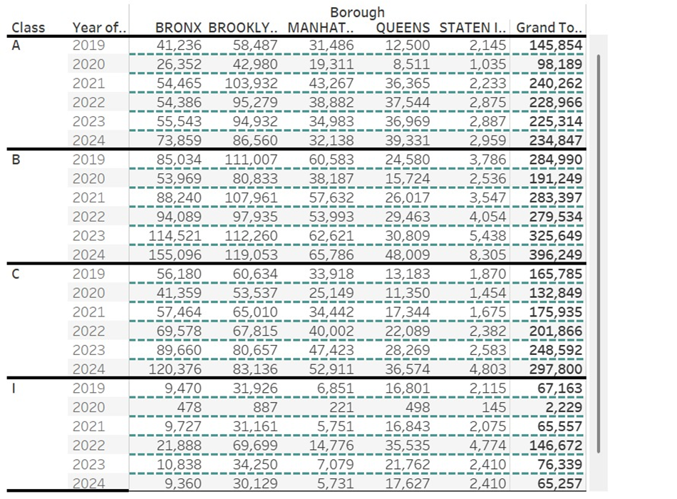
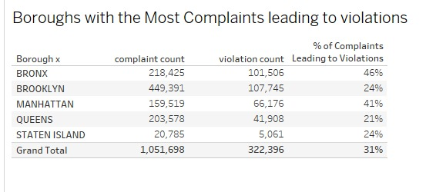


Old table
New table

Slide 6
Comparison between old and new table
Simplification & Summarization:
The new table aggregates data, summarizing complaint counts, violation counts, and percentage conversion rates instead of breaking them down by year and violation class.This makes it easier to see overall trends without needing to analyze multiple rows.
Enhanced Readability:
The old table had a dense structure, making it harder to interpret at a glance. The new table is more compact and presents key insights concisely.
New Metric (% of Complaints Leading to Violations):
The new table introduces a percentage column that shows how many complaints resulted in violations per borough.This provides additional insight into enforcement efficiency or the likelihood of complaints translating into actual violations.
Better Comparison Across Boroughs:
The new table makes it easy to compare boroughs directly by displaying total complaint and violation counts side by side, without having to scan through multiple years and classes.

Slide 7

Table 2: Key Insights
Borough Comparison:
Brooklyn has the highest number of total complaints at 249,345, suggesting it may have more residents or a higher frequency of issues.
Bronx follows with 217,563 complaints, indicating a substantial number of reported problems as well.
Queens, Manhattan, and Staten Island have fewer complaints, with Staten Island being the lowest at 32,720.
Major Categories:
Heat/Hot Water has the highest number of complaints in multiple boroughs, especially in Brooklyn (107,493) and the Bronx (81,003), indicating potential issues with heating systems that may need addressing.
Plumbing also shows significant complaints, particularly in Brooklyn (46,137) and Bronx (38,133), suggesting a need for plumbing infrastructure improvements.Other categories like Electric and Water Leak also contribute to the overall complaint count, with notable figures in all boroughs.
Issue Distribution:
The data suggests specific areas (like Brooklyn and Bronx) may require targeted interventions for heating and plumbing issues, given the high number of related complaints.
Focus Areas for Improvement:
The boroughs with the highest complaint counts should be prioritized for resource allocation and infrastructure improvements to address the most pressing issues reported by residents.

Slide 8
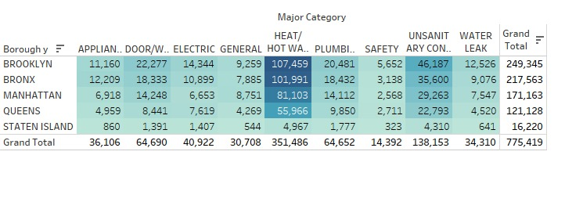
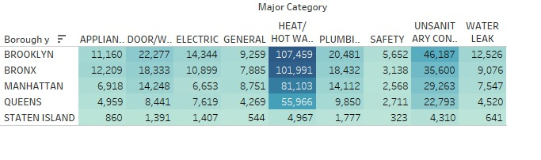
Table 2

Slide 9
Table 3: Following up on the violations that may have risen from complaints following are key insights on improving service delivery:
Heat/Hot Water:
This is a major issue across all boroughs with high complaint volumes. Prioritize addressing it.
Resolution Times Vary:
Queens and Staten Island generally resolve complaints faster, while the Bronx has the longest resolution times.
Borough-Specific Challenges:
Bronx: Longest resolution times for Heat/Hot Water, Water Leaks, and Plumbing.
Staten Island: Longest resolution time for Paint/Plaster.
Appliance/Electrical: These issues are generally resolved relatively quickly.

Slide 10
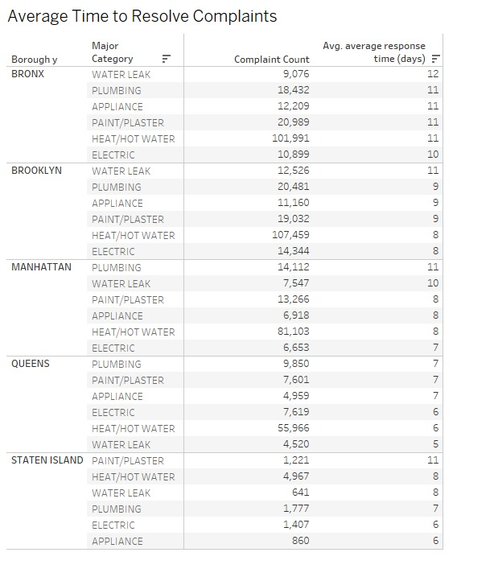
Table 3

Slide 11
Table 4 presents a follow up on the average time take to resolve a complaint.
Insights:
Significant Increase in Closed Problems: There's a noticeable increase in the number of closed problems from 467,297 in 2020 to 828,151 in 2024. This could indicate improved problem-solving efficiency or an increase in overall activity.
Open Problems Fluctuations: While closed problems have increased, the number of open problems has fluctuated. It peaked in 2024 at 14,908, significantly higher than previous years. This might suggest a recent surge in new issues or challenges in resolving them.
2024 as an Outlier: 2024 shows a dramatic increase in both closed and open problems compared to previous years. This could be due to various factors, such as a change in the scale of operations, a new type of problem, or a change in the tracking methodology.

Slide 12
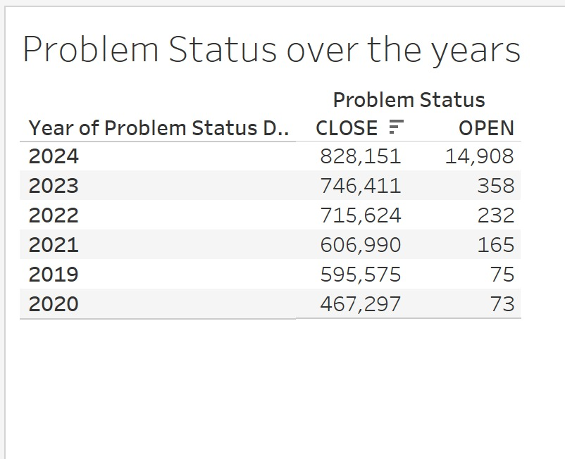
Table 4

Slide 13
Bar graph comparisons
The new graph provides a more insightful and visually appealing analysis of complaint data also provides a more intuitive and informative representation of complaint data across the years.
Visual Clarity:
The new graph uses a bar graph format with distinct colors for each year, making it easier to differentiate between years and see trends briefly.
Trend Visualization:
It effectively shows changes in complaint counts over time for each borough, allowing for quick comparisons and insights into patterns.
Comprehensive Data:
While the old graph presents data by year, the new graph combines data from multiple years in one view, making it easier to analyze longer-term trends.

Slide 14
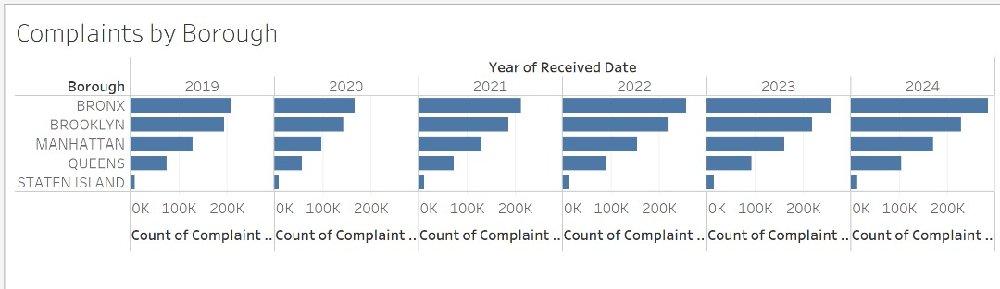
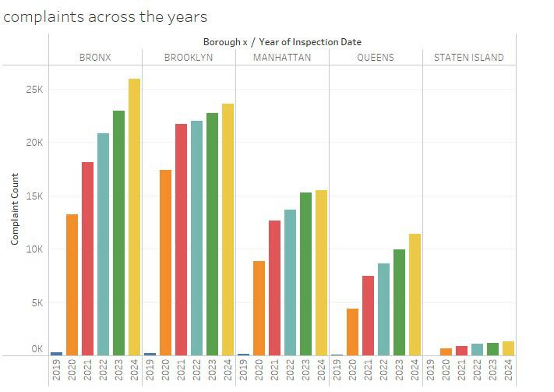
old Graph
new Graph
Bar Graph

Slide 15
New Bar Graph
Key insights:
Water Leak Complaints Show the Most Volatility: Water leak complaints exhibit the most significant percentage changes year-over-year. There's a dramatic increase in 2022, followed by decreases in subsequent years. This suggests that water leak issues may be particularly sensitive to specific events or conditions.
Heat/Hot Water Complaints Show a General Decreasing Trend: Heat/Hot Water complaints generally show a decrease in 2021, and then a trend of increase, suggesting improvements in this area in 2021, but a return to worse conditions in other years.
Plumbing Complaints are Relatively Stable: Plumbing complaints show more consistent changes, with increases in some years and decreases in others, but the fluctuations are not as extreme as with water leaks.
Appliance Complaints have a general increasing trend: Appliance complaints generally show an increasing trend over the years, with some minor decreases.
Electric Complaints have a general increasing trend: Electric complaints generally show an increasing trend over the years, with some minor decreases.

Slide 16
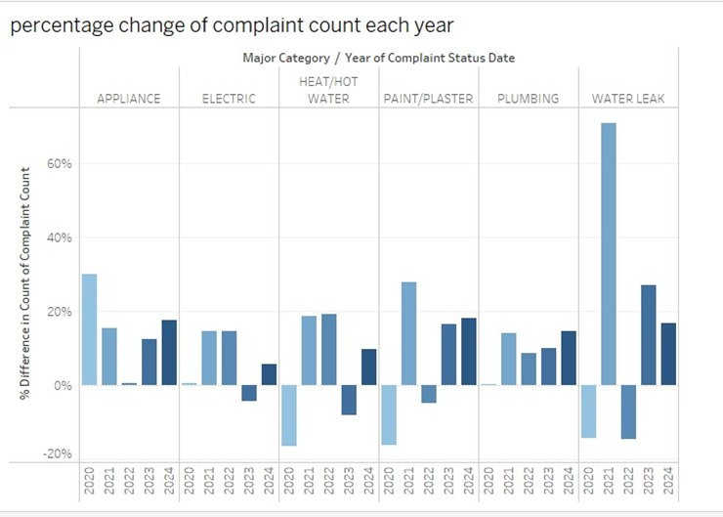
New Bar Graph

Slide 17
Box Plot
Purpose of the Data:
This dataset provides a detailed analysis of the spread of complaints in New York City from 2019 to 2024, segmented by borough. It aims to uncover trends and variations in community concerns over time.
Data Composition:
The visualization displays the count of complaints received each year, categorized by borough: Bronx, Brooklyn, Manhattan, Queens, and Staten Island.Each borough's data is represented in box plots, which illustrate the distribution, median, and range of complaints for each year.

Slide 18
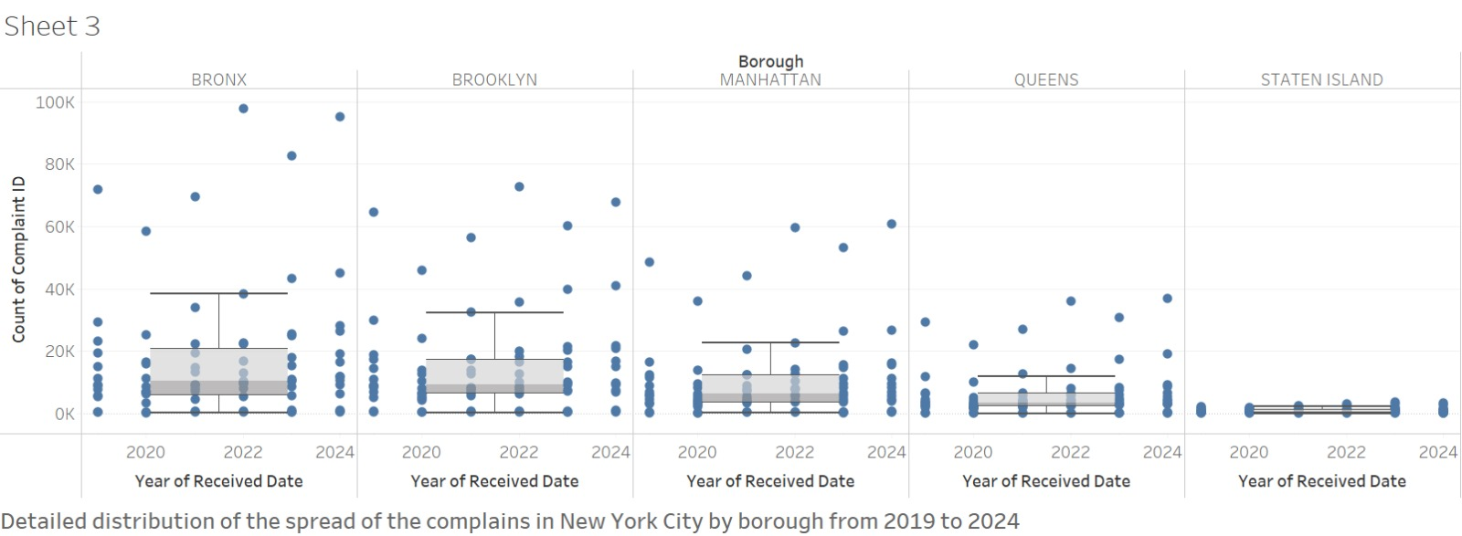
Box plot

Slide 19
Line Chart
Purpose of the Data:
This dataset provides a monthly trend analysis of complaints over the year, categorized by various complaint types. It aims to identify patterns and fluctuations in New York complaints major categories throughout the year.
Data Composition:
The line graph illustrates the count of complaints received each month, segmented by major categories such as appliance issues, elevator problems, plumbing, and more.Each complaint type is represented by its own line, allowing for easy comparison and identification of trends across different categories. Heat/ hot water is high in December and January because they are the coldest months of the year.

Slide 20
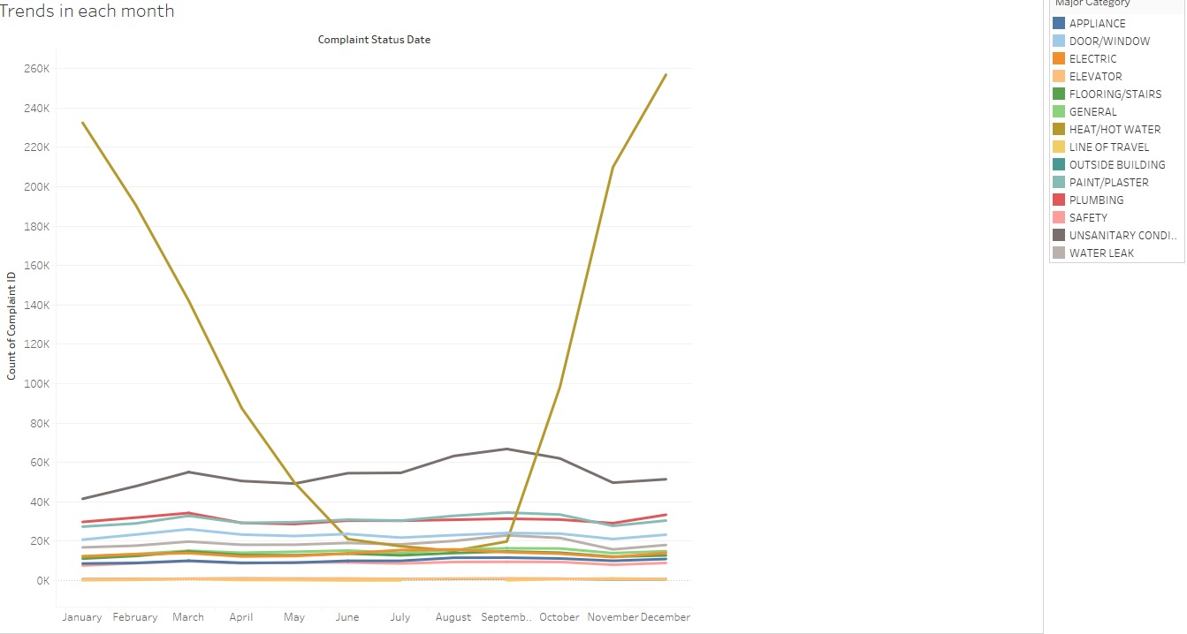
Line Chart

Slide 21
Improved Heatmap
Data Density Visualization:
The new heat map effectively shows areas of higher complaint density, allowing for quick identification of hotspots, which is more informative than the individual points in the old heat map. The new heat map is showing the distribution of complaints across all boroughs in the New York City. The size of each circle represents the complaints at that zip code.
Geospatial Context:
The new heat map provides a clearer representation of geographic distribution across the entire area, offering a more comprehensive view of where complaints are concentrated. Old Map is showing the distribution of complains across the Bronx borough only and the size doesn’t show the complaint counts.
Visual Appeal:
The heat map format is visually engaging and can capture more information with less clutter compared to the point-based representation in the old heat map.

Slide 22
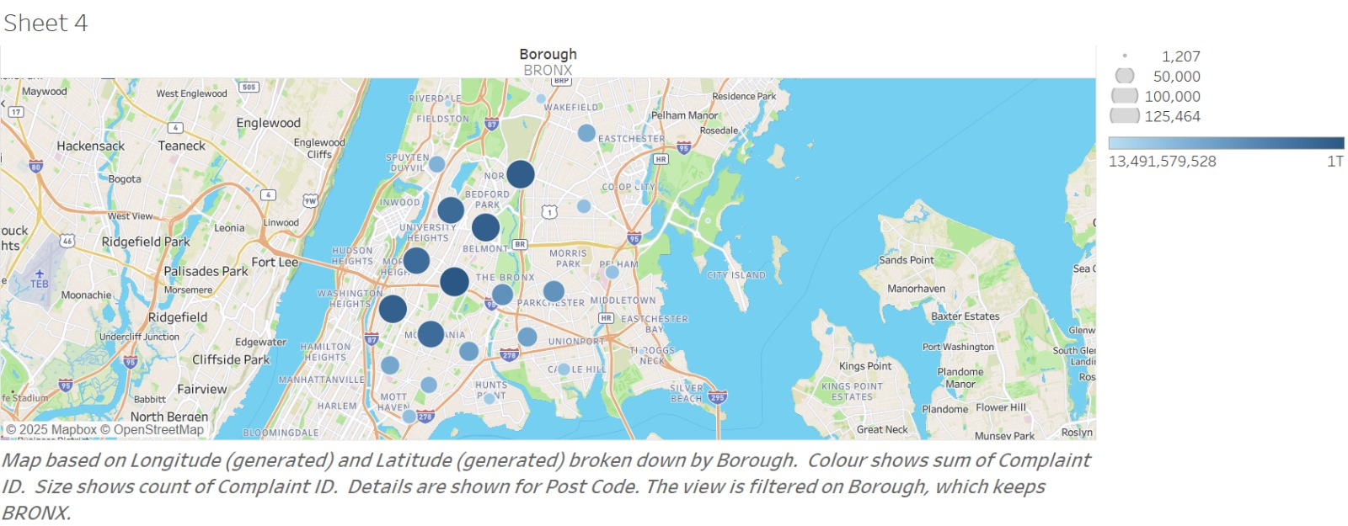
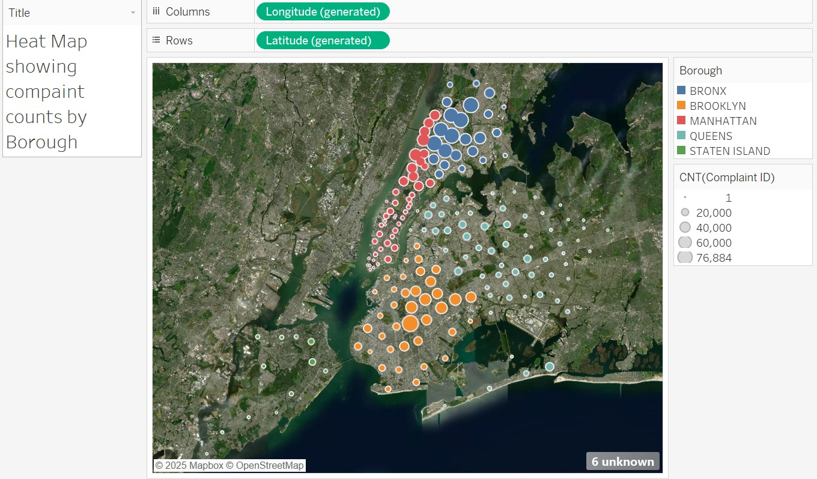
old map
new map
Heat map

Slide 23
New Heat Map Overview:
This heat map visualizes complaint counts by borough, providing a geographic overview of service demand across the area. It highlights where complaints are concentrated, helping to identify hotspots that may require urgent attention.
Key Features:
Borough Representation: The map clearly delineates complaints by borough—Bronx, Brooklyn, Manhattan, Queens, and Staten Island—allowing for easy identification of geographic trends.
Complaint Density: Different colors represent varying complaint counts, with a gradient indicating areas of higher and lower complaint volumes. The larger and more intense the color, the higher the number of complaints.
Insights:
Identifying Hotspots:
Areas with the highest complaint counts can be quickly identified, enabling targeted interventions. For example, if Brooklyn shows a concentration of complaints, this could indicate specific issues that need addressing.
Geographic Trends: Understanding the geographic distribution of complaints can inform resource allocation and operational strategies, ensuring that teams are deployed effectively.

Slide 24
Thank You

